Slide 1

Project Proposal
A Virtual Assistant
Presented By
Advisor
Dr. D Stalin Alex
Professor
Hasibul Islam
UG02-40-15-020
Mobassira Atika
UG02-41-16-010
Prachurja Kanti Barman Praggo
UG02-49-18-002
Department of Computer Science and Engineering
State University of Bangladesh
Department of Computer Science and Engineering
State University of Bangladesh

Slide 2
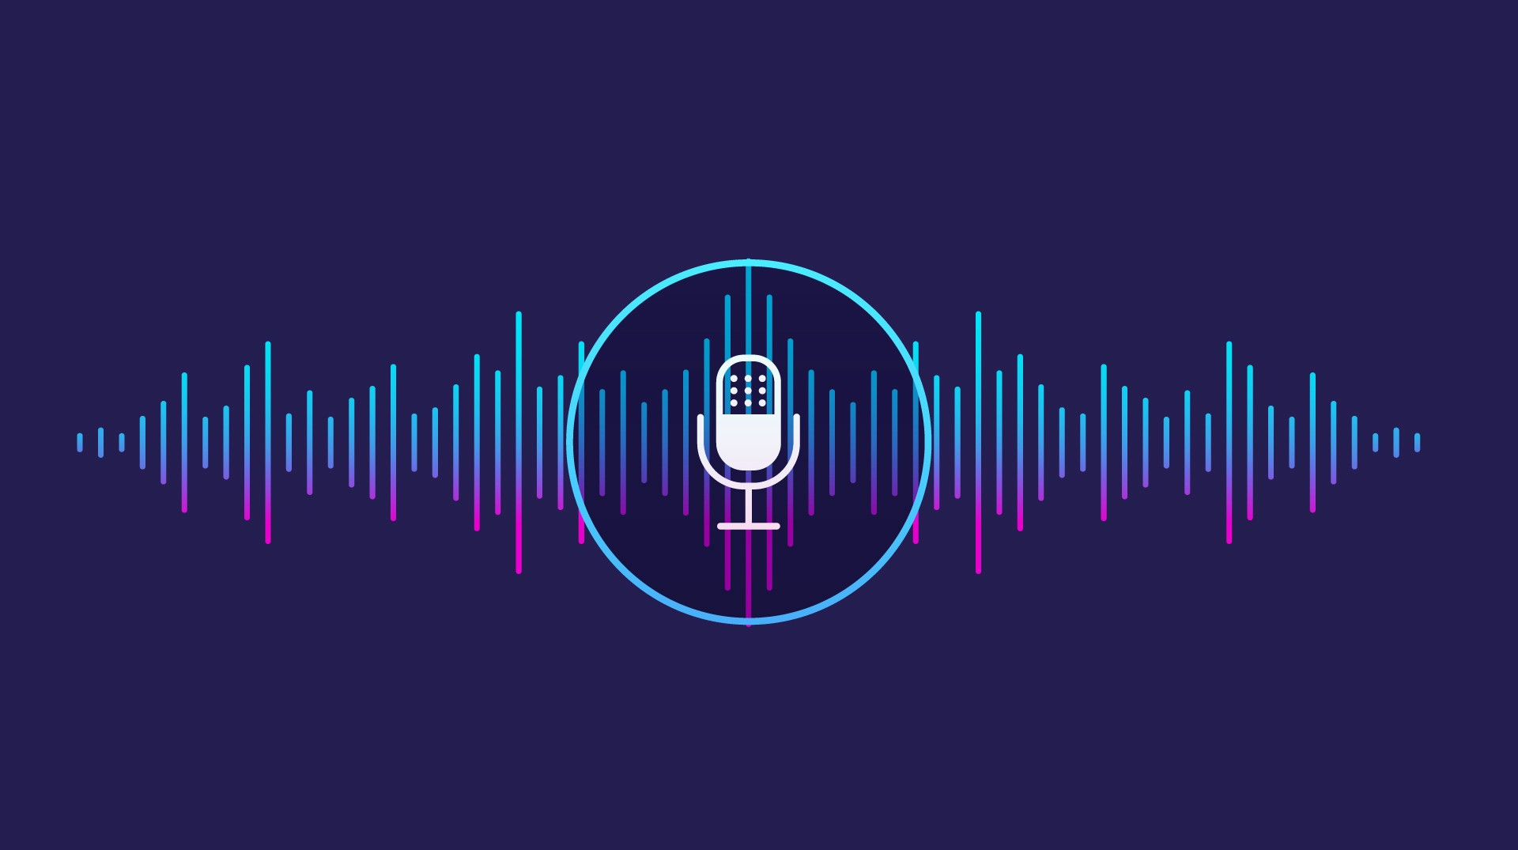
What is A virtual assistant?
AI assistant or digital assistant
An application program
Understands natural language voice commands
Completes tasks for the user
Machine to run on your command

Slide 3

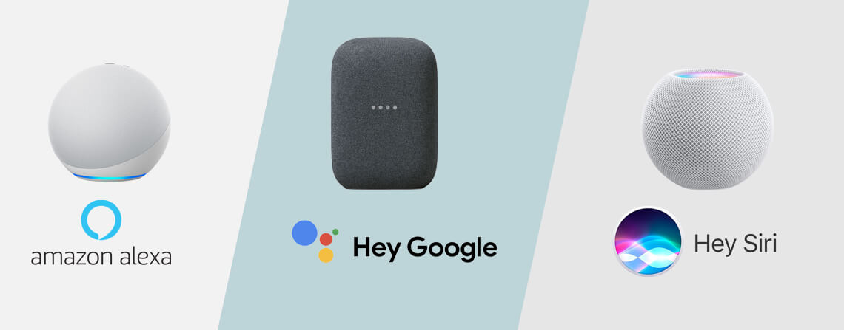
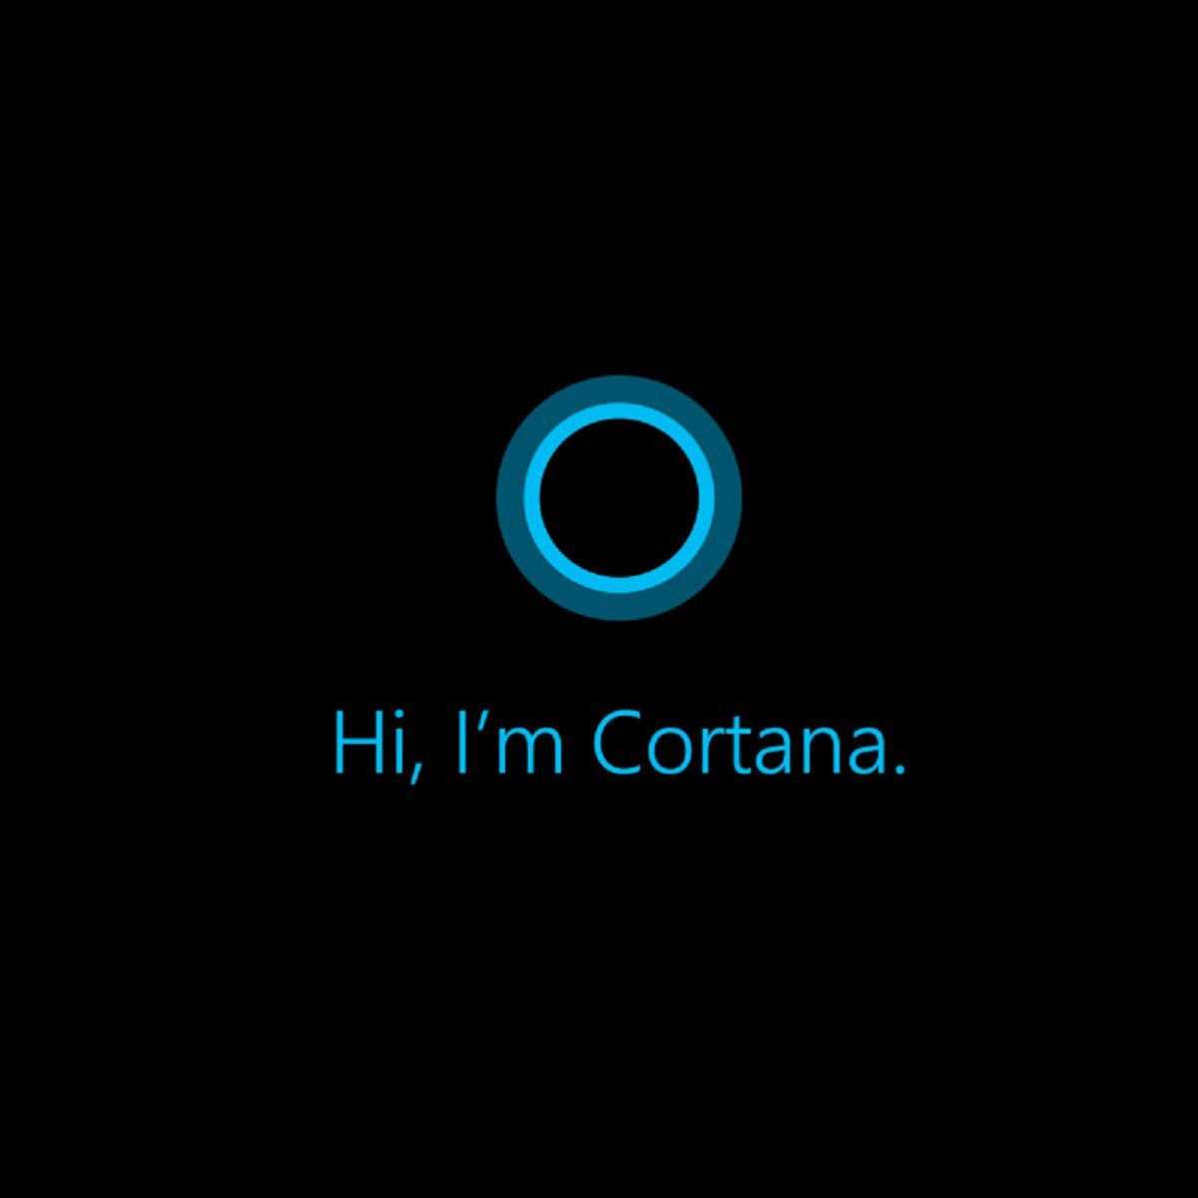
Available virtual assistance
Google’s Google Assistant
Apple’s Siri
Amazon’s Alexa
Microsoft’s Cortana

Slide 4
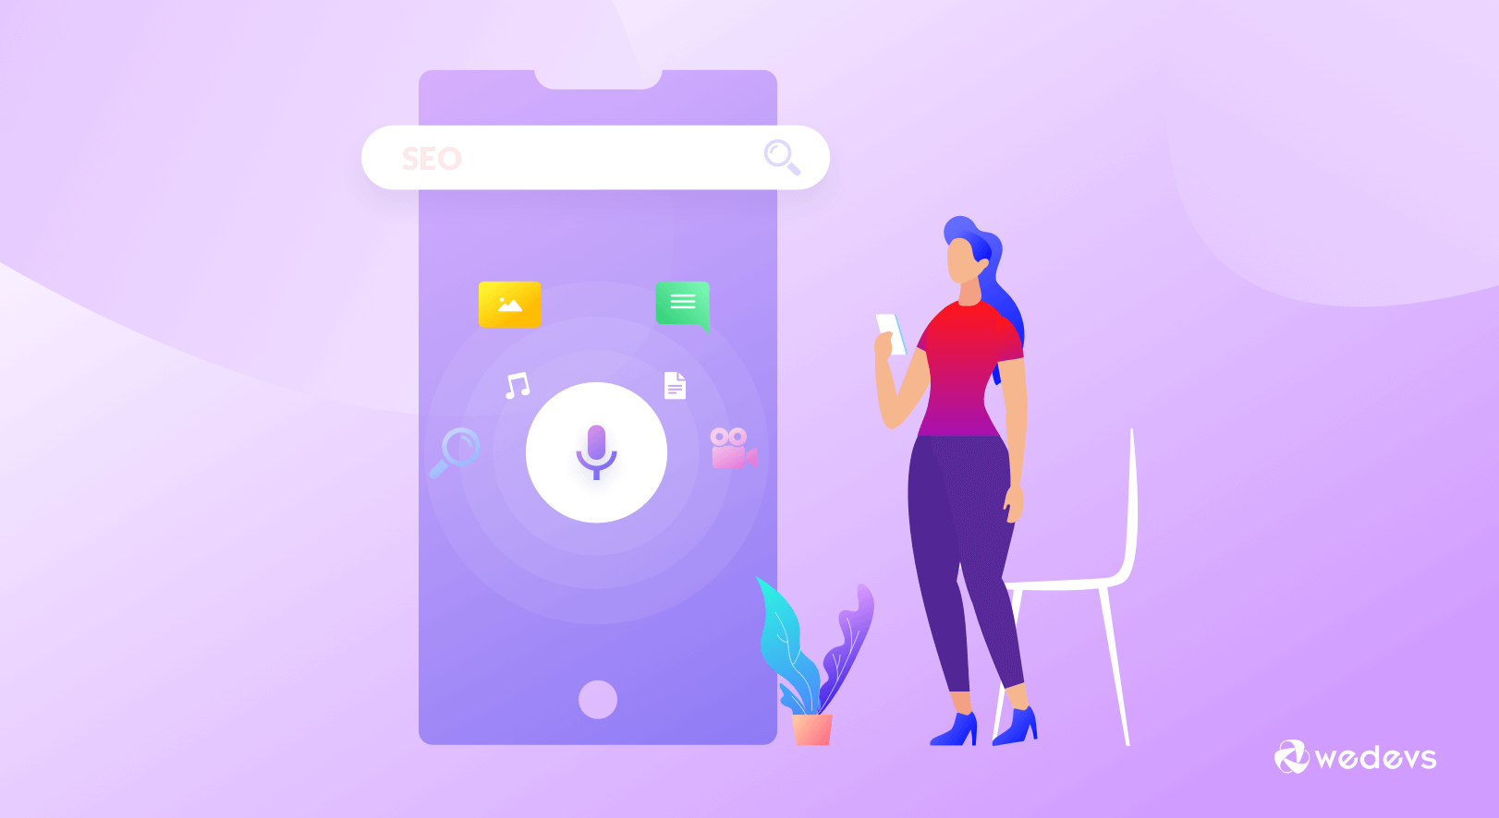
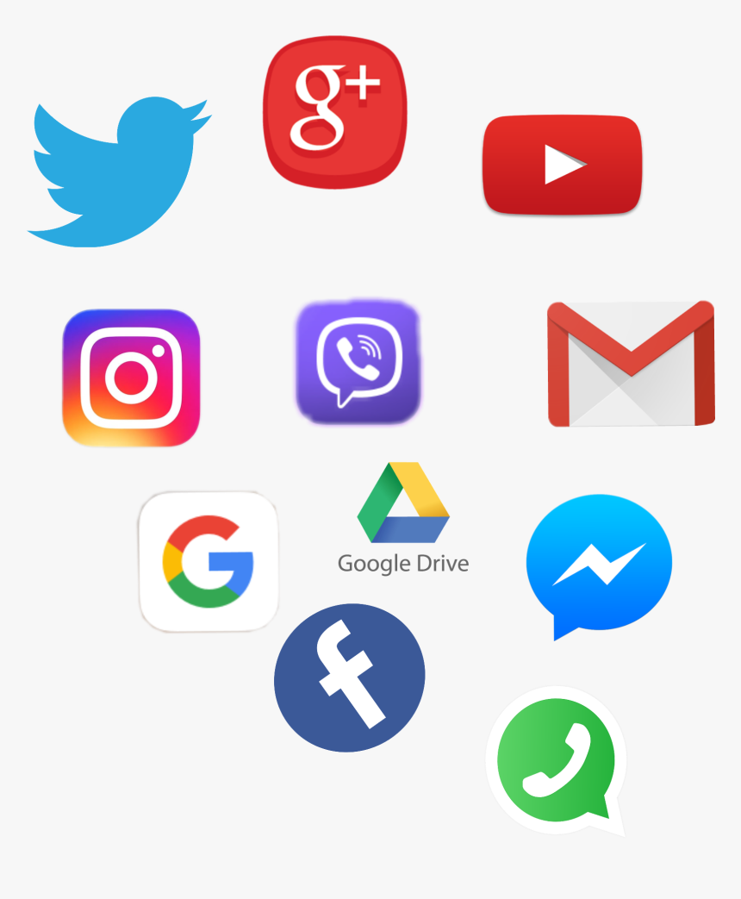


What we are building
Weather forecasting
Launch Games
Launch Windows Applications
Open Websites
Shut down windows
Tells jokes
Play songs through youtube

Slide 5


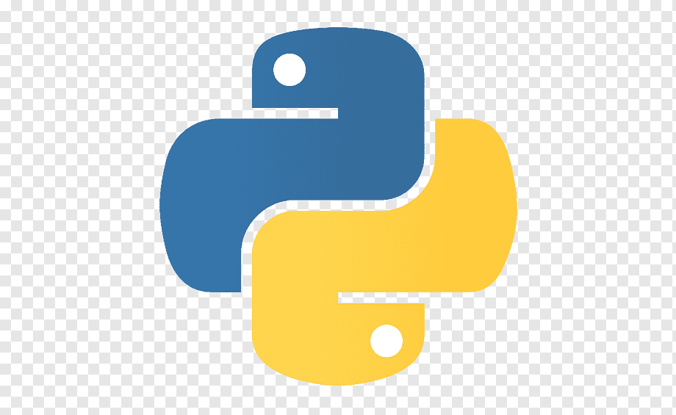
We are using
python 3
Pycharm community

Slide 6
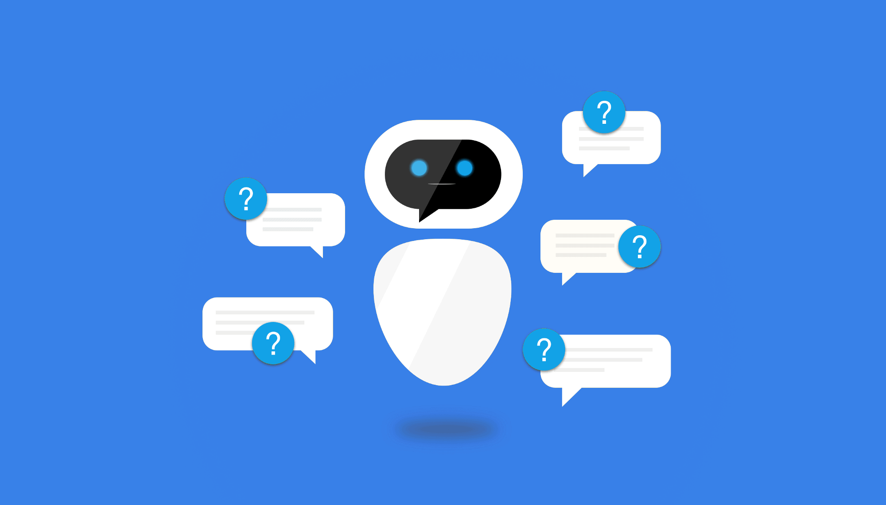
Benefits of personal Assistant
Improved Customer Engagement
Advanced Search Capabilities
Saves Time by Automating Repetitive Tasks
Aids Hand-free Operation
improve meeting experiences
Smart Working Environment
increase productivity
it can automate tasks and streamline workflows

Slide 7
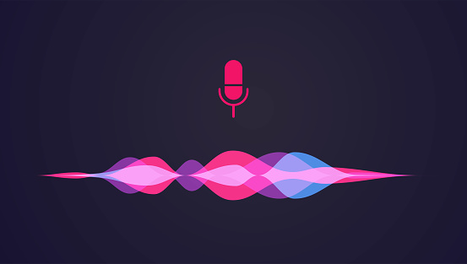
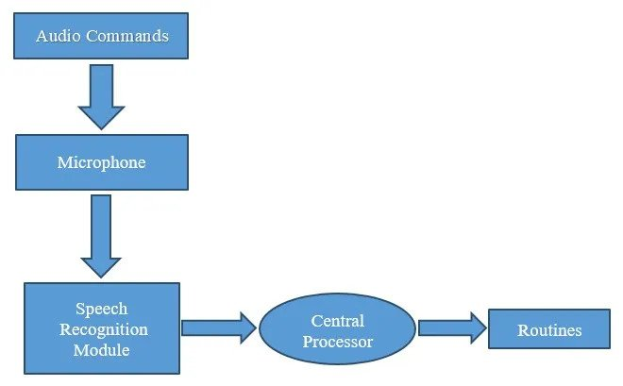
Proposed Plan Of Work

Slide 8

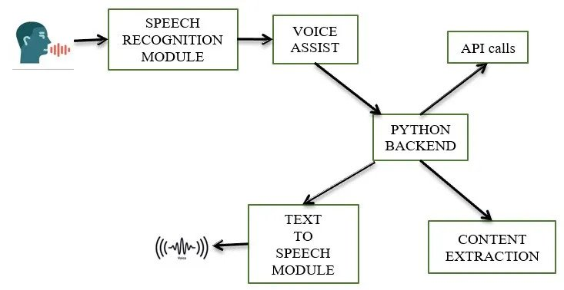
Methodology of Virtual Assistant

Slide 9
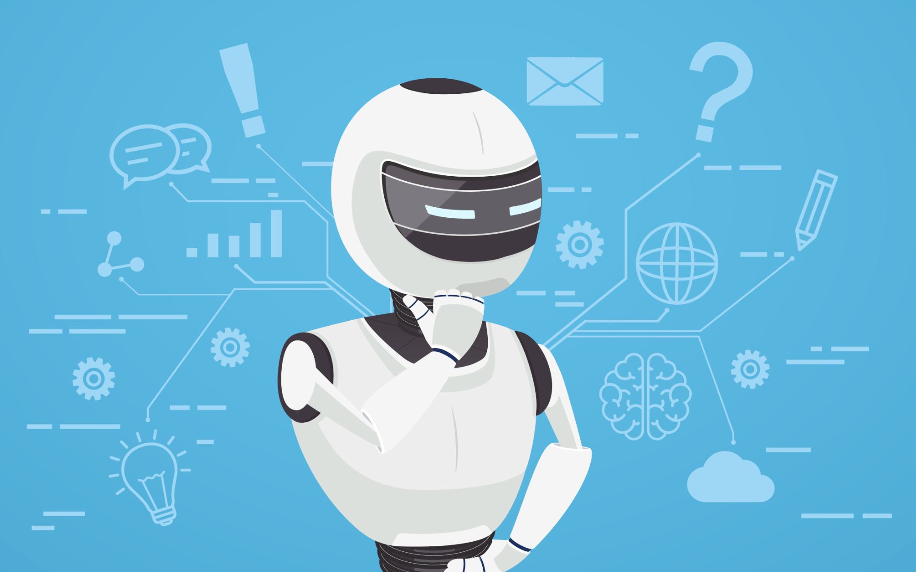
Algorithm needed
Subprocess :- (shut down, sleep etc)
WolframAlpha :- (compute expert-level answers using Wolfram’s algorithms)
Pyttsx3 :- (for the conversion of text to speech)
Wikipedia :- (Wikipedia module to get information )
Speech Recognition :- (assistant recognizes specific voice )
Web browser :- (To perform Web Search)
Ecapture :- (To capture images)

Slide 10

Algorithm needed
8. Pyjokes :- (collection of Python Jokes over the Internet)
9. Datetime :- (used to showing Date and Time)
10. Requests :- (is used for making GET and POST requests)
11. BeautifulSoup :- (scrape information from web pages)

Slide 11

Conclusion
undoubtedly the next big thing
AI voice bots
open source software modules
comfortable and feels free
interact with the voice assistant
Ask it questions
always ready to help

Slide 12
References
Serial No
References
01
Geetha, V., et al. "The Voice Enabled Personal Assistant for Pc using Python." International Journal of Engineering and Advanced Technology 10 (2021): 162-165.
02
Imrie, Peter, and Peter Bednar. "Virtual personal assistant." ItAIS (2013): 98-105
Akash, S., Neeraj Jayaram, and A. Jesudoss. "Desktop based Smart Voice Assistant using Python Language Integrated with Arduino." 2022 6th International Conference on Intelligent Computing and Control Systems (ICICCS). IEEE, 2022.
03
04
Subhash, S., et al. "Artificial intelligence-based voice assistant." 2020 Fourth World Conference on Smart Trends in Systems, Security and Sustainability (WorldS4). IEEE, 2020.

Slide 13


